Slide 1

Data Driven Applications
Web Applications
Data Access – PHP and MySQL
Lecture 01

Slide 2
Learning Outcomes
You will be able to describe and use the following
3 APIs for PHP-MySQL connection
Make a connection to a DB table using PHP and native MySQLi Object Oriented connection functions
Create and execute a query in SQL and PHP
Display results of a DB query in a web page
Format the results of the query in a web page using PHP and HTML

Slide 3
Setup
Make sure your Apache server is running – check your XAMPP control panel
In your htdocs folder make sure there is a subfolder for this topic
Eg ..C:/xampp/htdocs/K00999999/T02
Download and unzip the code for this lecture to this folder
Start NETBEANS
Open the netbeans project for this lecture at this location

Slide 4
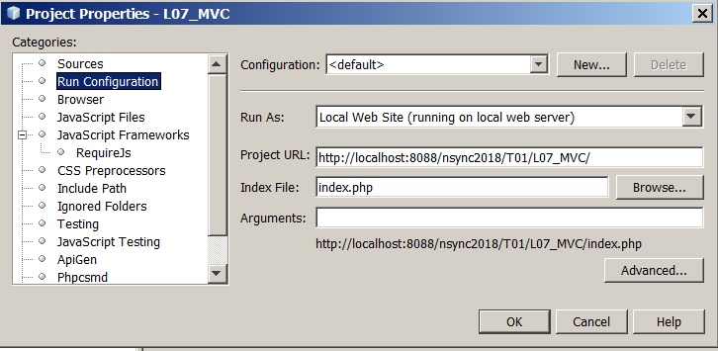
Configure NETBEANS project Properties
Right click on the project, select PROPERTIES/RUN CONFIGURATION
Set the PROJECT URL and index file to the correct one for your setup

Slide 5
Setting up MySQL database
To run these examples you will need a database set up
Restore the database that was provided as part of the PHP project you have just unzipped.
See the DATABASE folder
Notes:
CREATE DATABASE IF NOT EXISTS `k0xxxxxx_itschool` /*!40100 DEFAULT CHARACTER SET latin1 */;
USE `k0xxxxxx_itschool`;
-- MySQL dump 10.13 Distrib 5.6.24, for Win32 (x86)
--
-- Host: 127.0.0.1 Database: k0xxxxxx_itschool
-- ------------------------------------------------------
-- Server version 5.5.32
/*!40101 SET @OLD_CHARACTER_SET_CLIENT=@@CHARACTER_SET_CLIENT */;
/*!40101 SET @OLD_CHARACTER_SET_RESULTS=@@CHARACTER_SET_RESULTS */;
/*!40101 SET @OLD_COLLATION_CONNECTION=@@COLLATION_CONNECTION */;
/*!40101 SET NAMES utf8 */;
/*!40103 SET @OLD_TIME_ZONE=@@TIME_ZONE */;
/*!40103 SET TIME_ZONE='+00:00' */;
/*!40014 SET @OLD_UNIQUE_CHECKS=@@UNIQUE_CHECKS, UNIQUE_CHECKS=0 */;
/*!40014 SET @OLD_FOREIGN_KEY_CHECKS=@@FOREIGN_KEY_CHECKS, FOREIGN_KEY_CHECKS=0 */;
/*!40101 SET @OLD_SQL_MODE=@@SQL_MODE, SQL_MODE='NO_AUTO_VALUE_ON_ZERO' */;
/*!40111 SET @OLD_SQL_NOTES=@@SQL_NOTES, SQL_NOTES=0 */;
--
-- Table structure for table `lecturer`
--
DROP TABLE IF EXISTS `lecturer`;
/*!40101 SET @saved_cs_client = @@character_set_client */;
/*!40101 SET character_set_client = utf8 */;
CREATE TABLE `lecturer` (
`LectID` varchar(10) NOT NULL,
`FirstName` varchar(45) NOT NULL,
`LastName` varchar(45) NOT NULL,
`password` varchar(40) NOT NULL,
PRIMARY KEY (`LectID`)
) ENGINE=InnoDB DEFAULT CHARSET=latin1;
/*!40101 SET character_set_client = @saved_cs_client */;
--
-- Dumping data for table `lecturer`
--
LOCK TABLES `lecturer` WRITE;
/*!40000 ALTER TABLE `lecturer` DISABLE KEYS */;
INSERT INTO `lecturer` VALUES ('A00024','John','Smith','jones'),('A00029','Peter','Brady','peter'),('A00087','Mary','Murphy','mary'),('A00094','Elizabeth','O\'Brien','elizabet'),('A00132','Barry','O\'Connor','barry'),('A00231','John','Stapleton','john'),('A00845','John','O\'Connell','john');
/*!40000 ALTER TABLE `lecturer` ENABLE KEYS */;
UNLOCK TABLES;
--
-- Table structure for table `modules`
--
DROP TABLE IF EXISTS `modules`;
/*!40101 SET @saved_cs_client = @@character_set_client */;
/*!40101 SET character_set_client = utf8 */;
CREATE TABLE `modules` (
`ModuleID` varchar(10) NOT NULL DEFAULT '',
`ModuleTitle` varchar(45) NOT NULL,
`Credits` varchar(45) NOT NULL,
`LecturerID` varchar(10) DEFAULT NULL,
PRIMARY KEY (`ModuleID`),
KEY `FK_modules_1` (`LecturerID`),
CONSTRAINT `FK_modules_1` FOREIGN KEY (`LecturerID`) REFERENCES `lecturer` (`LectID`)
) ENGINE=InnoDB DEFAULT CHARSET=latin1;
/*!40101 SET character_set_client = @saved_cs_client */;
--
-- Dumping data for table `modules`
--
LOCK TABLES `modules` WRITE;
/*!40000 ALTER TABLE `modules` DISABLE KEYS */;
INSERT INTO `modules` VALUES ('AC230','Accounting 2','10','A00024'),('BA201','Business Administration','10','A00087'),('EN101','Introduction to Engineering','10','A00094'),('MA101','Mathematics 1','10','A00845'),('MA201','Mathematics 2','10','A00132'),('SC401','Chemistry 3','10','A00029');
/*!40000 ALTER TABLE `modules` ENABLE KEYS */;
UNLOCK TABLES;
--
-- Table structure for table `results`
--
DROP TABLE IF EXISTS `results`;
/*!40101 SET @saved_cs_client = @@character_set_client */;
/*!40101 SET character_set_client = utf8 */;
CREATE TABLE `results` (
`StudID` varchar(10) NOT NULL DEFAULT '',
`ModID` varchar(10) NOT NULL DEFAULT '',
`Grade` int(10) unsigned DEFAULT NULL,
PRIMARY KEY (`StudID`,`ModID`) USING BTREE,
KEY `FK_results_3` (`ModID`),
CONSTRAINT `FK_results_1` FOREIGN KEY (`ModID`) REFERENCES `modules` (`ModuleID`),
CONSTRAINT `FK_results_2` FOREIGN KEY (`StudID`) REFERENCES `students` (`StudentID`)
) ENGINE=InnoDB DEFAULT CHARSET=latin1;
/*!40101 SET character_set_client = @saved_cs_client */;
--
-- Dumping data for table `results`
--
LOCK TABLES `results` WRITE;
/*!40000 ALTER TABLE `results` DISABLE KEYS */;
INSERT INTO `results` VALUES ('K01001986','BA201',45),('K01012345','AC230',25),('K01022975','AC230',50),('K01022975','MA101',58),('K01023498','MA101',40),('K01087653','MA101',80),('K01123445','AC230',65),('K01234577','MA201',45);
/*!40000 ALTER TABLE `results` ENABLE KEYS */;
UNLOCK TABLES;
--
-- Table structure for table `students`
--
DROP TABLE IF EXISTS `students`;
/*!40101 SET @saved_cs_client = @@character_set_client */;
/*!40101 SET character_set_client = utf8 */;
CREATE TABLE `students` (
`StudentID` varchar(10) NOT NULL,
`FirstName` varchar(45) NOT NULL,
`LastName` varchar(45) NOT NULL,
PRIMARY KEY (`StudentID`) USING BTREE
) ENGINE=InnoDB DEFAULT CHARSET=latin1;
/*!40101 SET character_set_client = @saved_cs_client */;
--
-- Dumping data for table `students`
--
LOCK TABLES `students` WRITE;
/*!40000 ALTER TABLE `students` DISABLE KEYS */;
INSERT INTO `students` VALUES ('','',''),('K00239981','Peter ','Murphy'),('K01001986','Bill','Gates'),('K01012345','Alan','Ryan'),('K01022975','Jimi','Hendrix'),('K01023498','Tiger','Woods'),('K01087653','Michael ','Smith'),('K01123445','Jimmy','Chiu'),('K0123454','fef','efef'),('K0123456','hjhj','hgjhjkj'),('K01234577','Elvis','Costello'),('K0998877','jfjkd','jkklklkl;');
/*!40000 ALTER TABLE `students` ENABLE KEYS */;
UNLOCK TABLES;
/*!40103 SET TIME_ZONE=@OLD_TIME_ZONE */;
/*!40101 SET SQL_MODE=@OLD_SQL_MODE */;
/*!40014 SET FOREIGN_KEY_CHECKS=@OLD_FOREIGN_KEY_CHECKS */;
/*!40014 SET UNIQUE_CHECKS=@OLD_UNIQUE_CHECKS */;
/*!40101 SET CHARACTER_SET_CLIENT=@OLD_CHARACTER_SET_CLIENT */;
/*!40101 SET CHARACTER_SET_RESULTS=@OLD_CHARACTER_SET_RESULTS */;
/*!40101 SET COLLATION_CONNECTION=@OLD_COLLATION_CONNECTION */;
/*!40111 SET SQL_NOTES=@OLD_SQL_NOTES */;
-- Dump completed on 2017-02-08 11:57:54

Slide 6
PHP MySQL APIs
There are 3 APIs (Application Programming Interfaces) to choose from when connecting to MySQL from PHP
ext/MySQL – MySQL procedural only interface (deprecated)
ext/MySQLi – MySQL OO and procedural
ext/PDO
We are going to use MySQLi in the following examples

Slide 7
Web Application – Examples
Ex01 – Connects to DB and Disconnects, performs error checks
Ex02 – Performs a SELECT query and displays the result
Ex03 – dynamically creating HTML tables

Slide 8
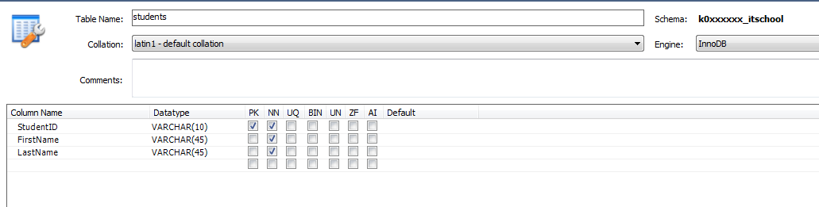
View – STUDENTS table

Slide 9
Ex01 Connect to MySQL using MySQLi
Specify the connection parameters – see config/database.php
These examples assume the user is ‘root’ and password is blank. Port 3306 is the default.
//Define Connection Parameters//
$DBServer = ‘127.0.0.1'; // e.g 'localhost' $DBUser = 'root'; //username
$DBPass = ''; //password
$DBName = 'college'; //database name

Slide 10
Store connection to db separately
Storing the DB connection in a separate file (connection.php) means that it can be included in any script that needs it.
If connection parameters need to be changed for all scripts – only one edit is required.
include(“CONFIG/connection.php");

Slide 11
Ex01 Connect to MySQL using MySQLi
Before you can access and work with data in a MySQL database, you must create a connection to the database.
Use mysqli::__construct to make the connection object
//make the connection
$db = new mysqli($DBServer, $DBUser, $DBPass, $DBName);
Manual : http://php.net/manual/en/book.mysqli.php

Slide 12
Check the connection was successful
If the connection is unsuccessful the script is terminated or re-directed as appropriate
mysqli::$dbect_errno — Returns the error code from last connect call
This example displays an error message
if ($db->connect_error) {
echo "<p>Database connection failed:”;
}

Slide 13
Ex01 Use the connection object if successful
Display the connection object properties
//display connection parameters
echo '<p>MySQL Server Connection information :<br>';
echo "Client connection info string : $db->client_info <br>";
echo "Server Version [as decimal release]: $db->server_info <br>";
echo "Server Version [as integer] : $db->server_version <br>";
echo "Server Character Set : $db->character_set_name() <br>";
echo "Host info : $db->host_info() <br>";

Slide 14
Close the DB connection
Good practice to include this:
//close the database connection
$db->close();

Slide 15
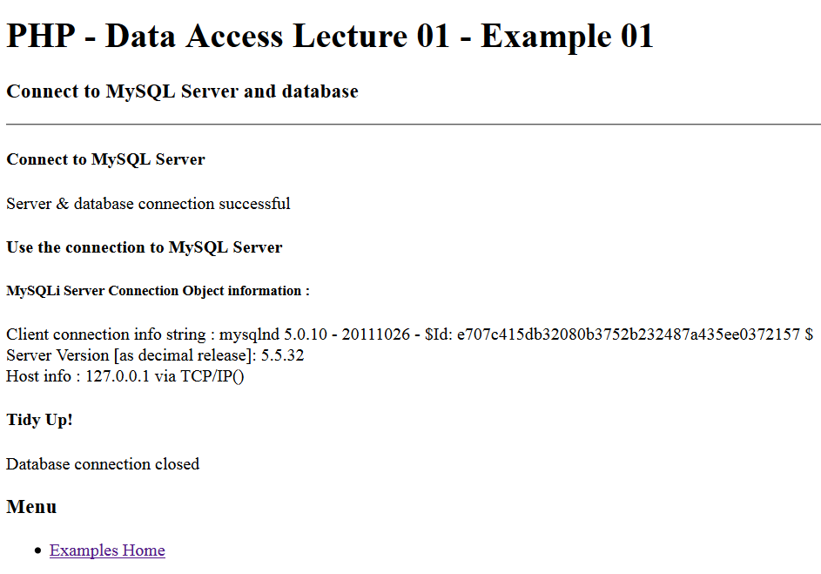
Example 1 – in browser
Try changing some of the connection parameters in the file connection.php and reload this page.

Slide 16
Ex02 Execute a SELECT query
In this example the output is formatted into a HTML table
First - Define the SQL Query to be executed:
//Define the query to be executed
$sql="SELECT * FROM students";

Slide 17
Ex2 – execute the query
$rs is the result set returned from a query attempt
It will return FALSE if unsuccessful
It will return a mysqli_result class object if successful
mysqli::query — Performs a query on the database - Data inside the query SQL should be properly escaped.
//execute the query
if($rs=$db->query($sql)){
echo '<br>Query has been Executed<br>';
}
else{
echo '<br>SQL Query has FAILED <br>';
}
Manual : http://php.net/manual/en/mysqli.query.php

Slide 18
Display resultset properties (metadata)
Resultset properties are accessible through the resultset object ($rs) (mysqli_result — The mysqli_result class)
These properties can be used to process the data
<h3>Resultset properties:</h3>
<ul>
<li>Rows Returned=<?php echo $rs->num_rows;?></li>
<li>Current Field Pointer=<?php echo $rs->current_field;?></li>
<li>Number of Fields=<?php echo $rs->field_count;?></li>
</ul>

Slide 19
Iterate through the $rs resultset to show the query result in a table
This uses ‘while’ to iterate through $arr
$rs->fetch_assoc() – returns an associative array for a single row.
while ($row = $rs->fetch_assoc()) {
echo ' '.
$row["StudentID"].' '.
$row["FirstName"].' '.
$row["LastName"].'<br>';
}
if (!$rs->num_rows){
echo 'No records have been returned - resultset is empty - Nr Rows = '.$rs->num_rows. '<br>';
}

Slide 20
Ex03 – Put results in a HTML table
This example takes the resultset and iterates through its data – formatting the results into an HTML table

Slide 21
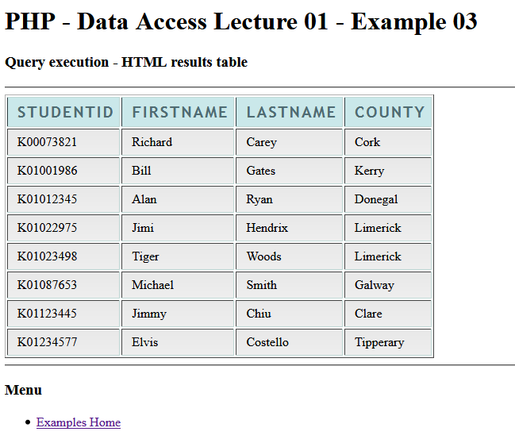
Iterate through the $rs resultset to show the query result in a table
Table is formatted using CSS

Slide 22
Close the DB connection and free resultset memory
Good practice to include this:
//free result set memory
$rs->free();
//close the database connection
$db->close();

Slide 23
mysqli_result class
Properties
int $current_field ;
int $field_count;
array $lengths;
int $num_rows;
Methods
bool data_seek ( int $offset )
mixed fetch_all ([ int $resulttype = MYSQLI_NUM ] )
mixed fetch_array ([ int $resulttype = MYSQLI_BOTH ] )
array fetch_assoc ( void )
object fetch_field_direct ( int $fieldnr )
object fetch_field ( void )
array fetch_fields ( void )
object fetch_object ([ string $class_name = "stdClass" [, array $params ]] )
mixed fetch_row ( void )
bool field_seek ( int $fieldnr )
void free ( void )
Items highlighted in red used in Ex2 and Ex3
Manual : http://php.net/manual/en/class.mysqli-result.php

Slide 24
Exercise L01
Create an interactive PHP form application.
A drop down menu – containing the names of all the tables in the college database.
The list of tables in the drop down menu should be generated automatically from a query to the MySQL database.
When a table is selected and the associated SUBMIT button is pressed the table data should be displayed in a formatted HTML table.
Hint: to get a list of tables from a database use the following SQL: show tables;

Slide 25
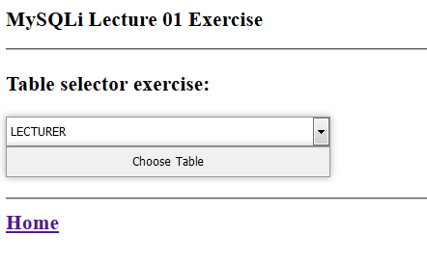
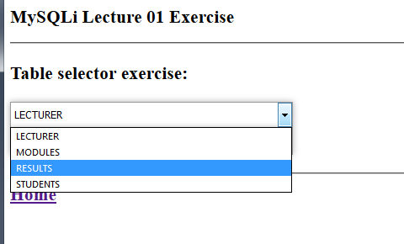
Exercise 01
The table names in the drop down menu are generated from a model representing the table names.

Slide 26
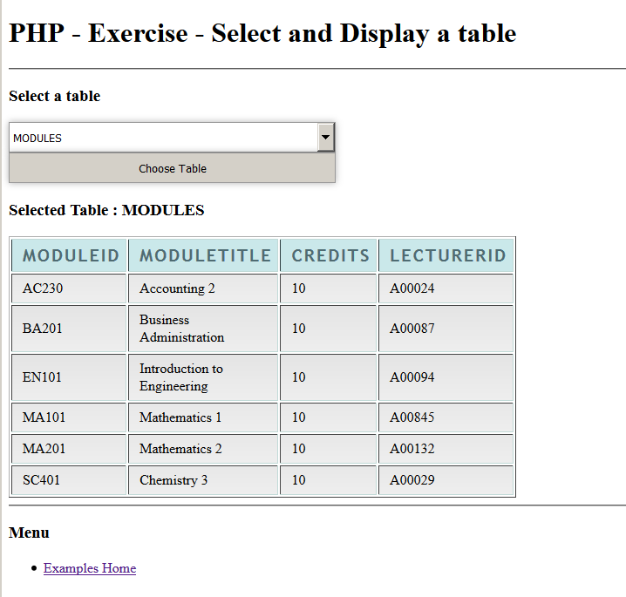
Exercise 01 - Result

